Slide 1
TAMIL NADU URBAN INTELLIGENCE REPORT
Demographics, Mobility, Transportation
& Weather — A Data-Driven Study
An integrated analysis of four datasets covering 38 districts, 1,000 transport trips,
96,453 weather readings, and 5,000 live mobility records.
Prepared with exploratory data analysis • August 2026

Slide 2
What We'll Cover
Four datasets, one connected story about how people, weather, and transport shape Tamil Nadu's cities.
01
Demographics
Population, density, literacy & growth across 38 districts
02
Transportation
Trip modes, fuel types, distances & emissions
03
Weather
96K+ readings — temperature, humidity & conditions
04
Mobility & Traffic
Real-time speed, congestion, accidents & demand
Tamil Nadu Urban Intelligence Report
2

Slide 3
Four Datasets, One Ecosystem
A combined view of population, movement, and environment across Tamil Nadu.
Demographic
Transportation
Weather
Mobility
38 districts
1,000 trips
96,453 readings
5,000 records
10 fields
12 fields
11 fields
16 fields
Population, area, density, literacy, sex ratio, growth rate
Mode, route, fuel type, distance, frequency, emissions
5-min intervals: temperature, humidity, wind, pressure
Live traffic speed, occupancy, accidents, sentiment, demand
Tamil Nadu Urban Intelligence Report
3

Slide 4
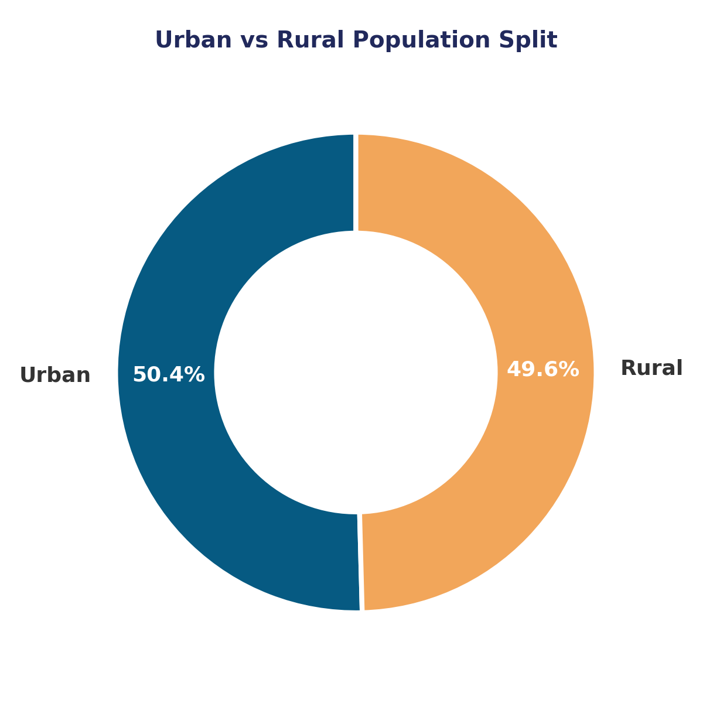
Demographics: Population at a Glance
Section 01 · State-wide totals derived from all 38 districts in the dataset.
76.5M
38
79.5%
9.0%
Total Population
Districts Covered
Average Literacy Rate
Average Growth Rate
Urban vs Rural Balance
Urban population: 38.59M (50.4%)
Rural population: 37.95M (49.6%)
Tamil Nadu's population is almost evenly split between urban and rural areas, reflecting a state in the middle of rapid urban transition. Chennai alone accounts for over 4.6M residents concentrated in just 175 sq. km — by far the state's most dense district.
Section 01 · Demographics
4

Slide 5
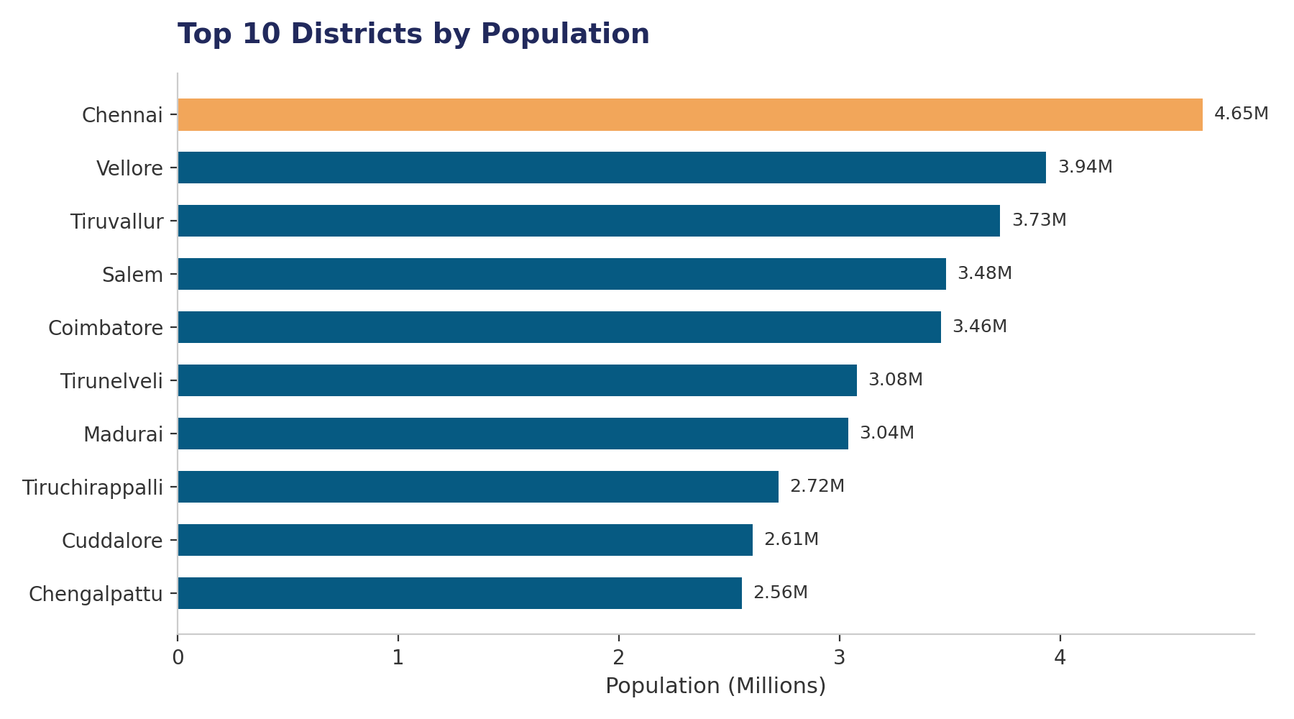
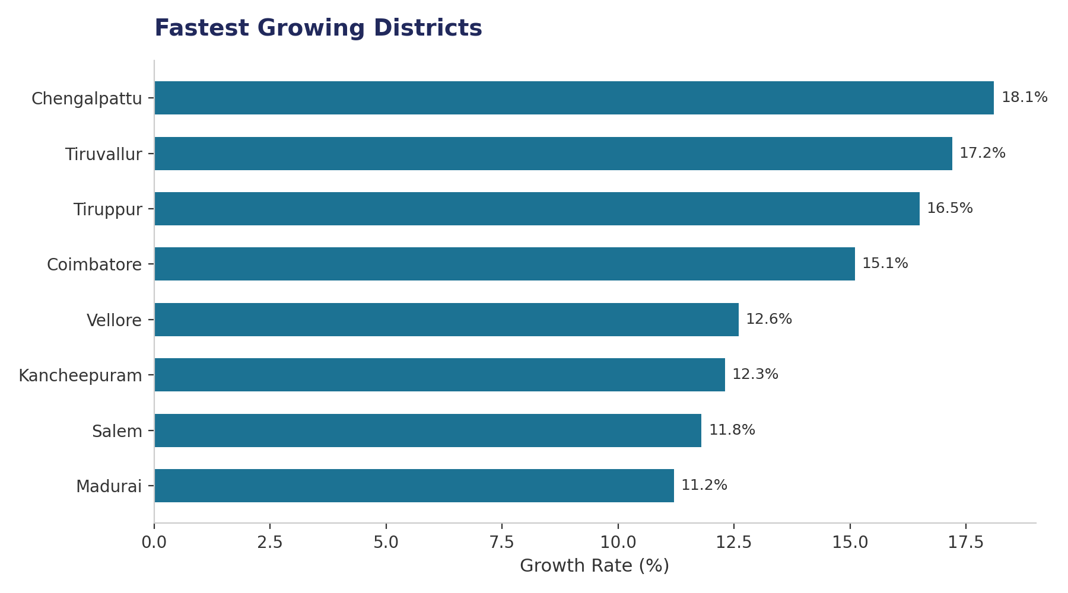
Where People Live & Where Growth Is Fastest
The most populous districts and the fastest-growing districts often differ.
Section 01 · Demographics
5

Slide 6
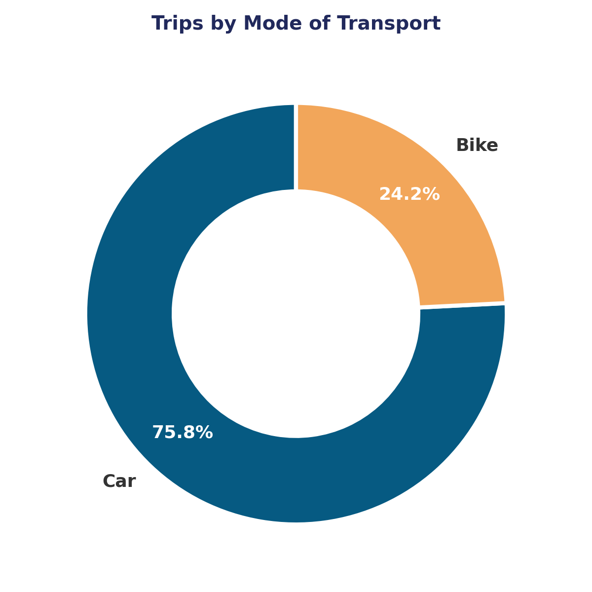
Transportation: Trip Patterns at a Glance
Section 02 · Summary of 1,000 logged trips across Tamil Nadu's cities.
13.6 mi
3.0x
25.1 mpg
58.4 kg
Average Trip Distance
Avg Weekly Frequency
Average Fuel Efficiency
Avg Monthly CO2 / Trip
Cars Dominate the Road
Cars account for 75.8% of all trips (758 of 1,000), with bikes making up the remaining 24.2%. Fuel type is nearly split down the middle — 51.4% electric vs 48.6% gasoline — showing meaningful EV adoption already underway across the surveyed trips. Average trip length holds steady at 13.6 miles regardless of mode.
Section 02 · Transportation
6

Slide 7
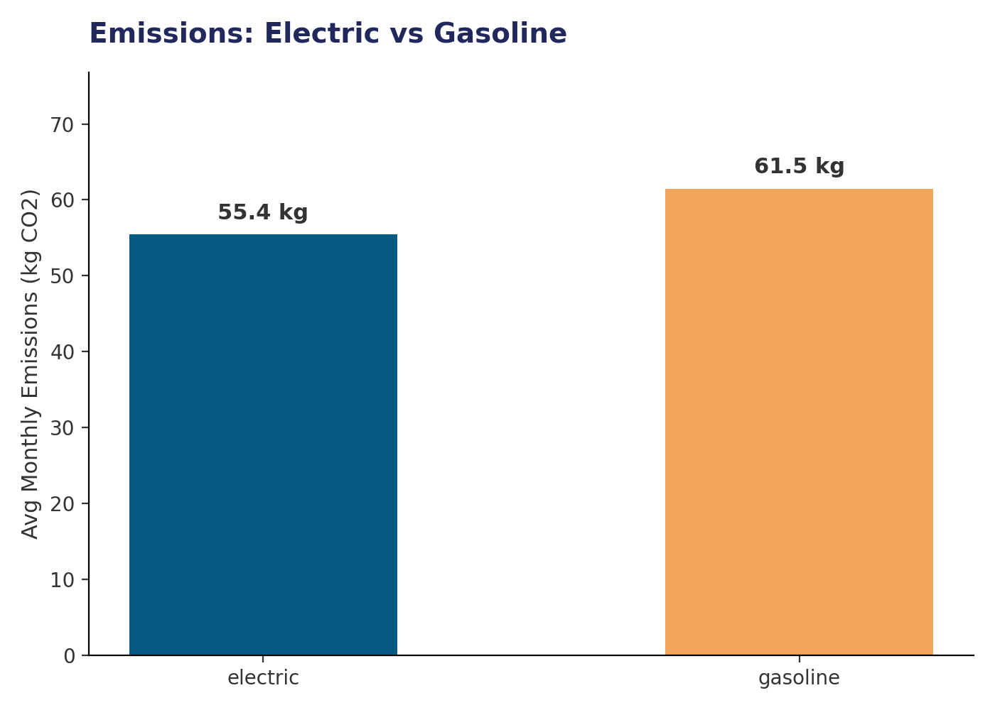
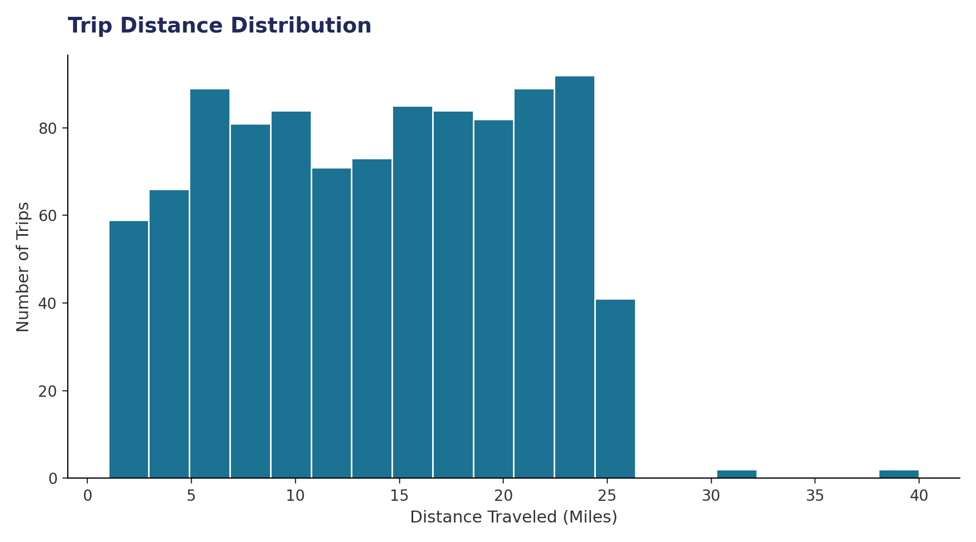
Emissions & Trip Distances
Electric vehicles cut monthly CO2 by ~10%; most trips fall in a short-to-medium distance band.
Section 02 · Transportation
7

Slide 8
Weather: Climate Snapshot
Section 03 · 96,453 readings collected at 5-minute intervals from March 2024 to January 2025.
11.9°C
-21.8° to 39.9°
73.5%
10.8 km/h
Average Temperature
Temperature Range
Average Humidity
Average Wind Speed
Overwhelmingly Cloudy Skies
Partly Cloudy (32.9%) and Mostly Cloudy (29.1%) together describe roughly 62% of all readings. Clear skies occur only 11.3% of the time, and rain/drizzle events are rare in this dataset window — under 0.2% combined. This suggests a persistently overcast, humid climate pattern typical of Tamil Nadu's coastal-influenced weather, with temperature staying fairly stable month to month (11–13°C average band).
Section 03 · Weather
8

Slide 9
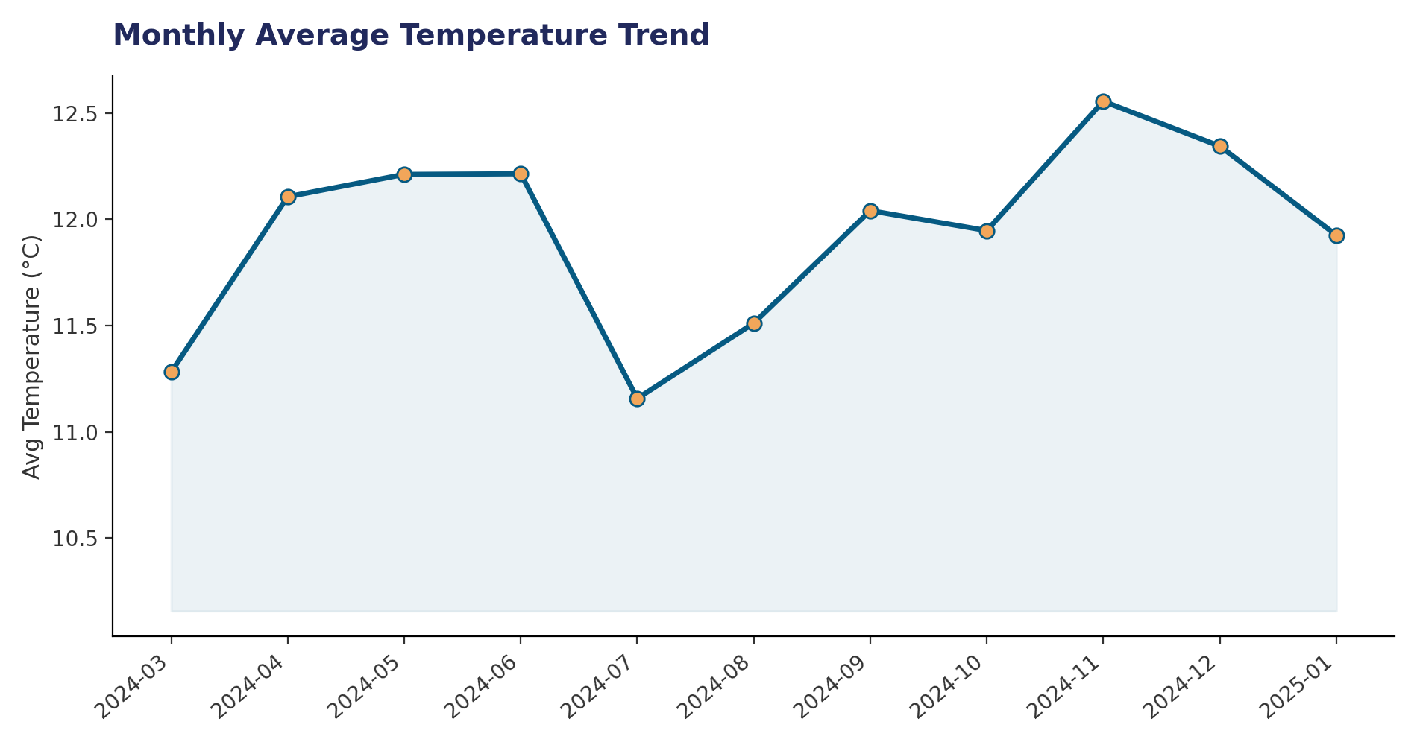
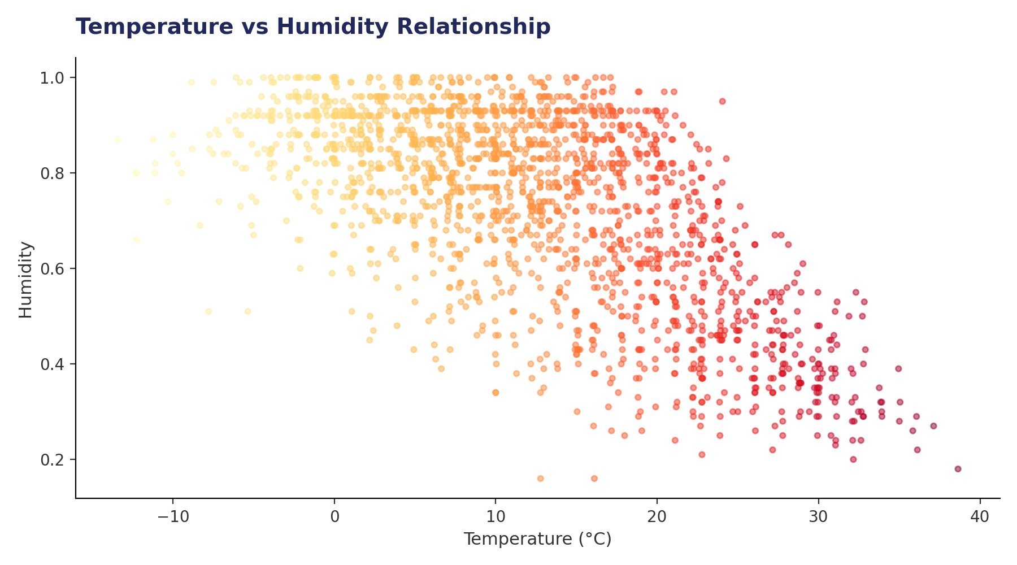
Temperature Trend & Humidity Relationship
Monthly averages stay within a 1.5°C band; humidity tends to fall as temperature rises.
Section 03 · Weather
9

Slide 10
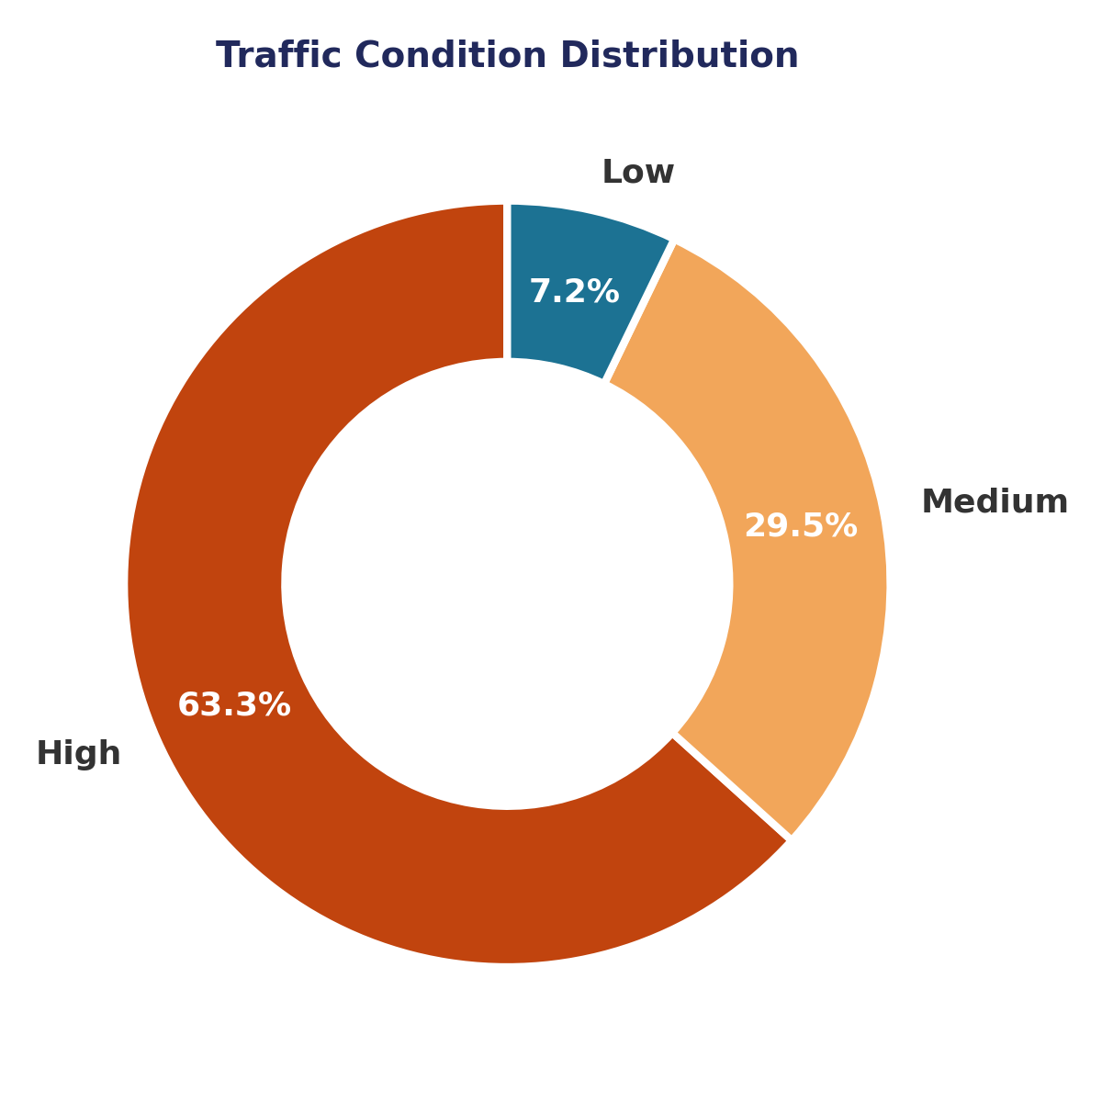
Mobility: Live Traffic Snapshot
Section 04 · Aggregated from 5,000 real-time mobility sensor records.
154
42.1 km/h
9.6%
50 / 25
Avg Vehicle Count
Avg Traffic Speed
Accident Rate
Avg Ride Demand / Parking
High Congestion Is the Norm
High-traffic conditions account for 63.3% of all records (3,166 of 5,000), with Medium at 29.5% and Low at just 7.2%. High-traffic periods average 182 vehicles present, more than 3x the 53 vehicles seen during Low-traffic windows — congestion is clearly the default state, not the exception, in this dataset.
Section 04 · Mobility
10

Slide 11
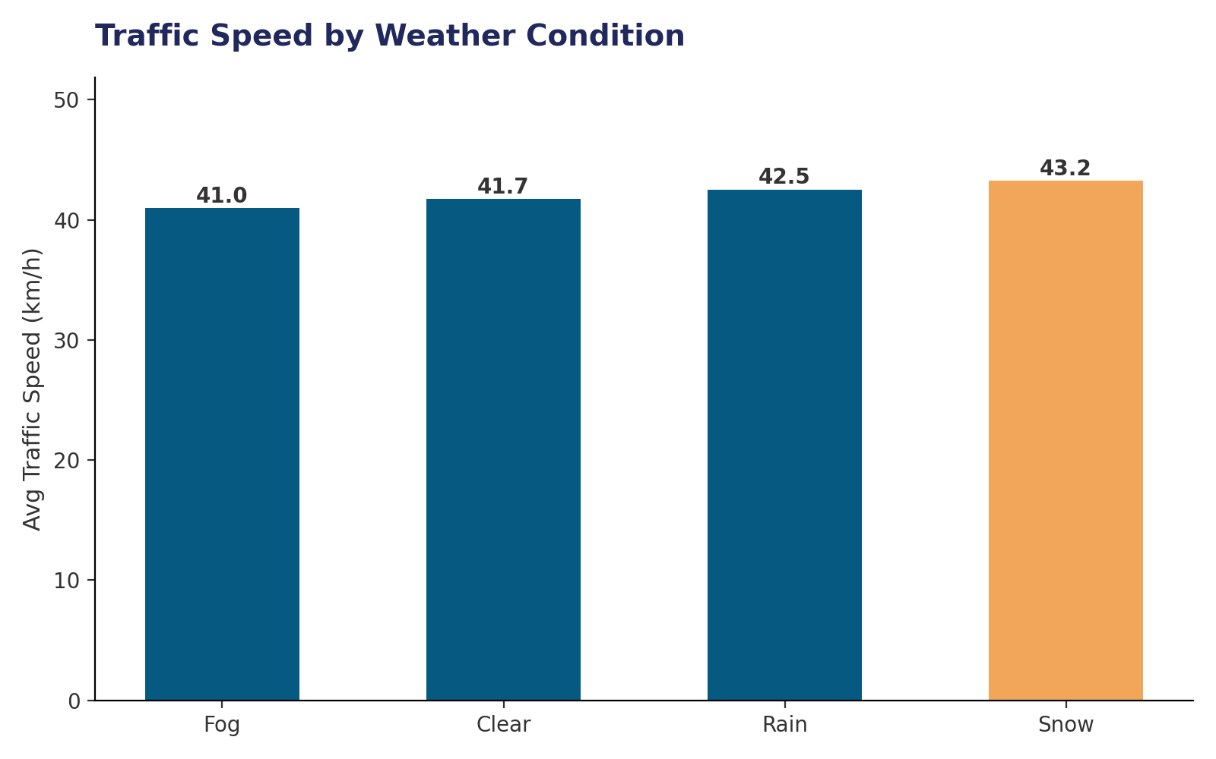
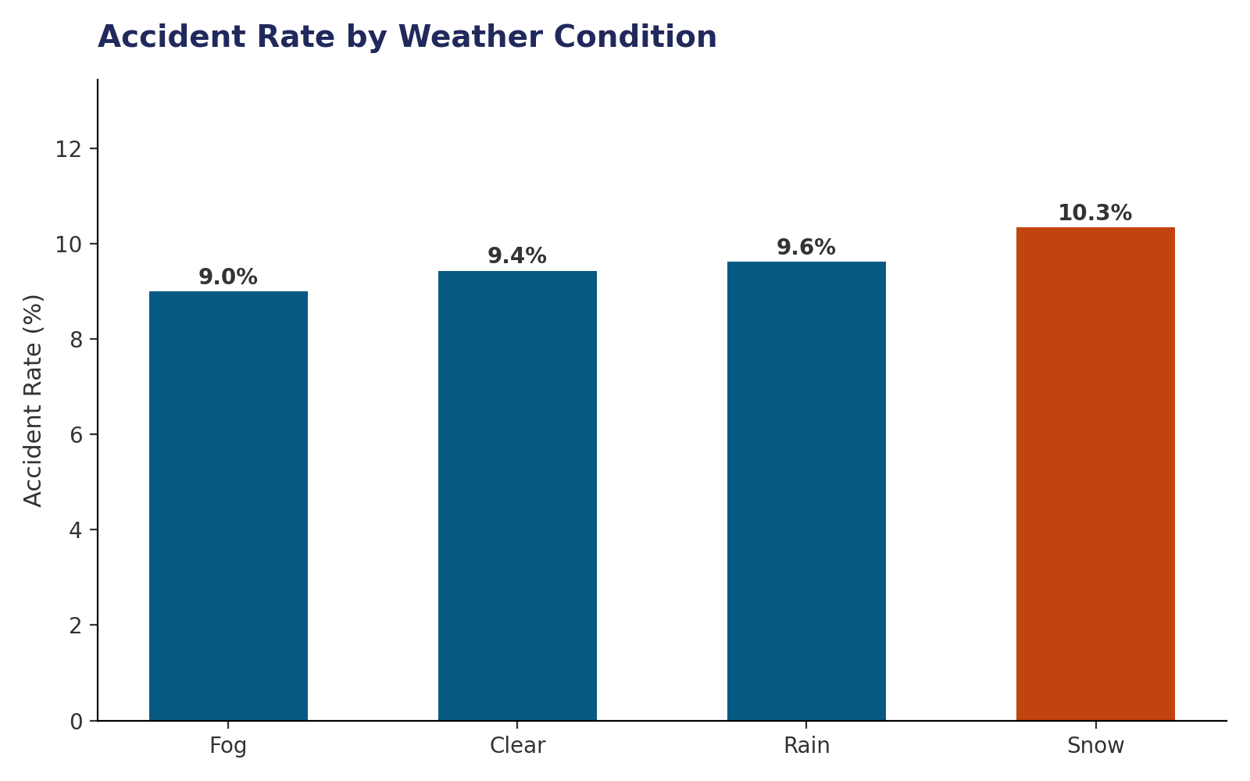
Weather's Effect on the Road
Average speeds hold steady or even rise in poor weather — but accident rates climb with it.
Section 04 · Mobility
11

Slide 12
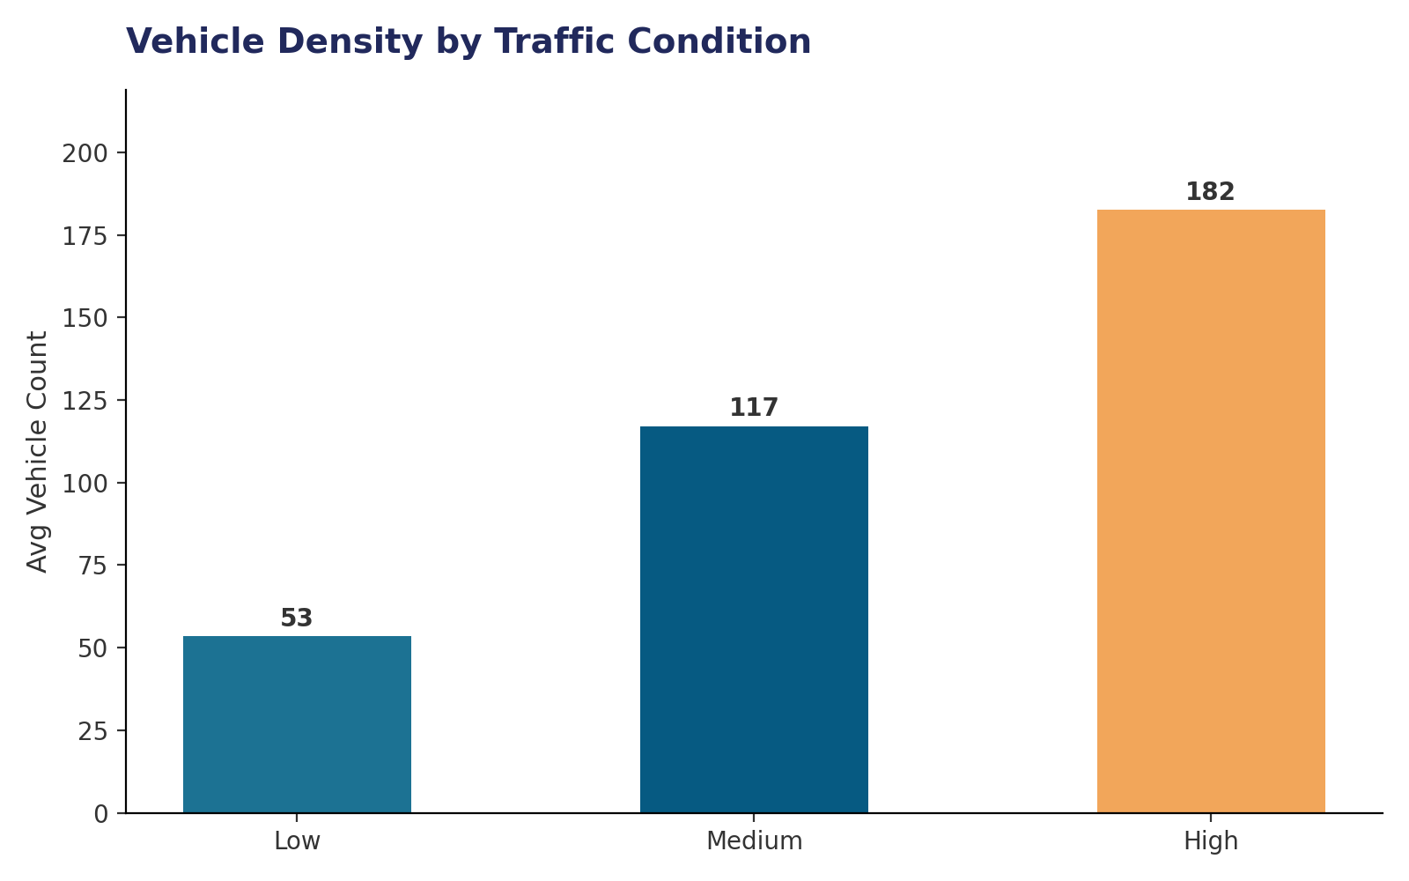
Vehicle Density Drives Traffic State
Traffic classification tracks tightly with the number of vehicles present at a given moment.
Signal Behavior
Traffic light state (Red/Yellow/Green) shows almost no effect on average speed — all three hover near 42 km/h. This suggests congestion in this network is driven more by vehicle volume and road occupancy than by signal timing alone, pointing toward volume-based interventions (route balancing, ride-share incentives) rather than signal retiming as the higher-leverage fix.
Section 04 · Mobility
12

Slide 13
Connecting the Dots
How demographics, weather, transport and mobility relate to one another.
1
Density Drives Demand
2
EVs Are Gaining Ground
Chennai's extreme density (26,553/km²) aligns with the high-traffic conditions dominating the mobility dataset — dense urban cores generate the most congestion pressure.
With 51% of logged trips already electric and a 10% emissions advantage over gasoline, transport decarbonization is already underway, not just aspirational.
3
Weather Raises Risk, Not Delay
4
Growth Corridors Need Capacity
Snow and rain correlate with higher accident rates (10.3% and 9.6%) despite similar or faster average speeds — a safety gap, not a speed gap.
Fast-growing districts near Chennai (Chengalpattu, Tiruvallur) will likely inherit the capital's congestion patterns as population and traffic scale together.
Cross-Dataset Insights
13

Slide 14
Recommendations
Data-informed actions for planners, transit authorities and policymakers.
Prioritize EV Infrastructure
1
Expand charging networks along high-growth corridors (Chengalpattu, Tiruvallur, Tiruppur) to sustain the current 51% electric trip share.
Target Volume, Not Just Signals
2
Since light state barely affects speed, invest in demand-side tools — carpooling incentives, staggered work hours, ride-share subsidies.
Weather-Aware Safety Alerts
3
Deploy real-time driver alerts during rain/snow conditions specifically, when accident rates climb even though speeds don't drop.
Plan Ahead of Growth
4
Fast-growing districts near Chennai should scale transit capacity proactively, using Chennai's density patterns as an early-warning template.
Recommendations
14

Slide 15
Thank You
Questions & discussion welcome.
Sources: Demographic, Transportation, Weather & Mobility datasets (Tamil Nadu, 2024–25)

